Slide 1
WIRELESS COMMUNICATIONS PROJECT
MOLECULAR COMMUNICATIONS: MODEL-BASED AND DATA-DRIVEN RECEIVER DESIGN AND OPTIMIZATION
BT_S21(ECE 311)
Group Members:
Aanshi Patwari(AU1841004)
Dipika Pawar(AU1841052)
Miracle Rindani(AU1841052)
Mithilesh Thakkar(AU1841038)

Slide 2
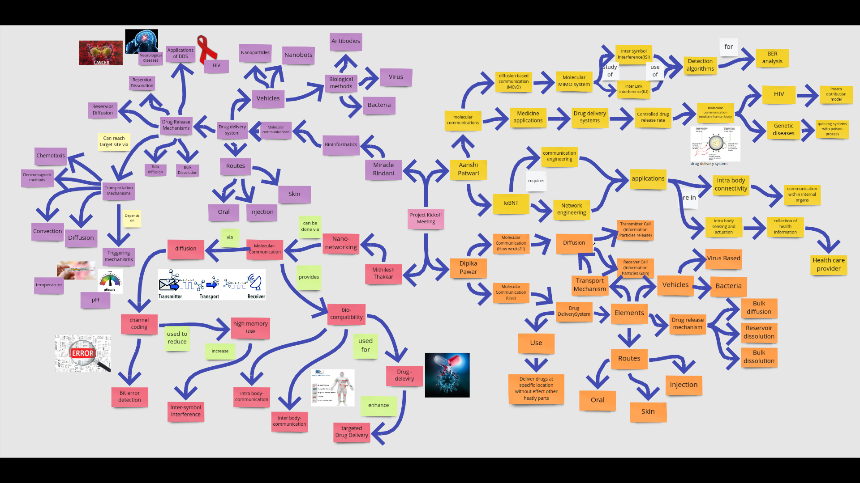
FRAME 1 BRAINSTORMING

Slide 3
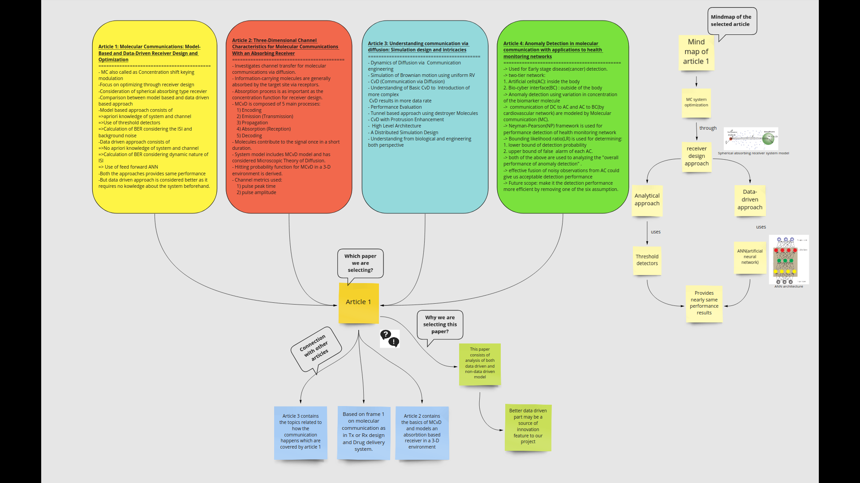
FRAME 2 TOPIC INTRO

Slide 4
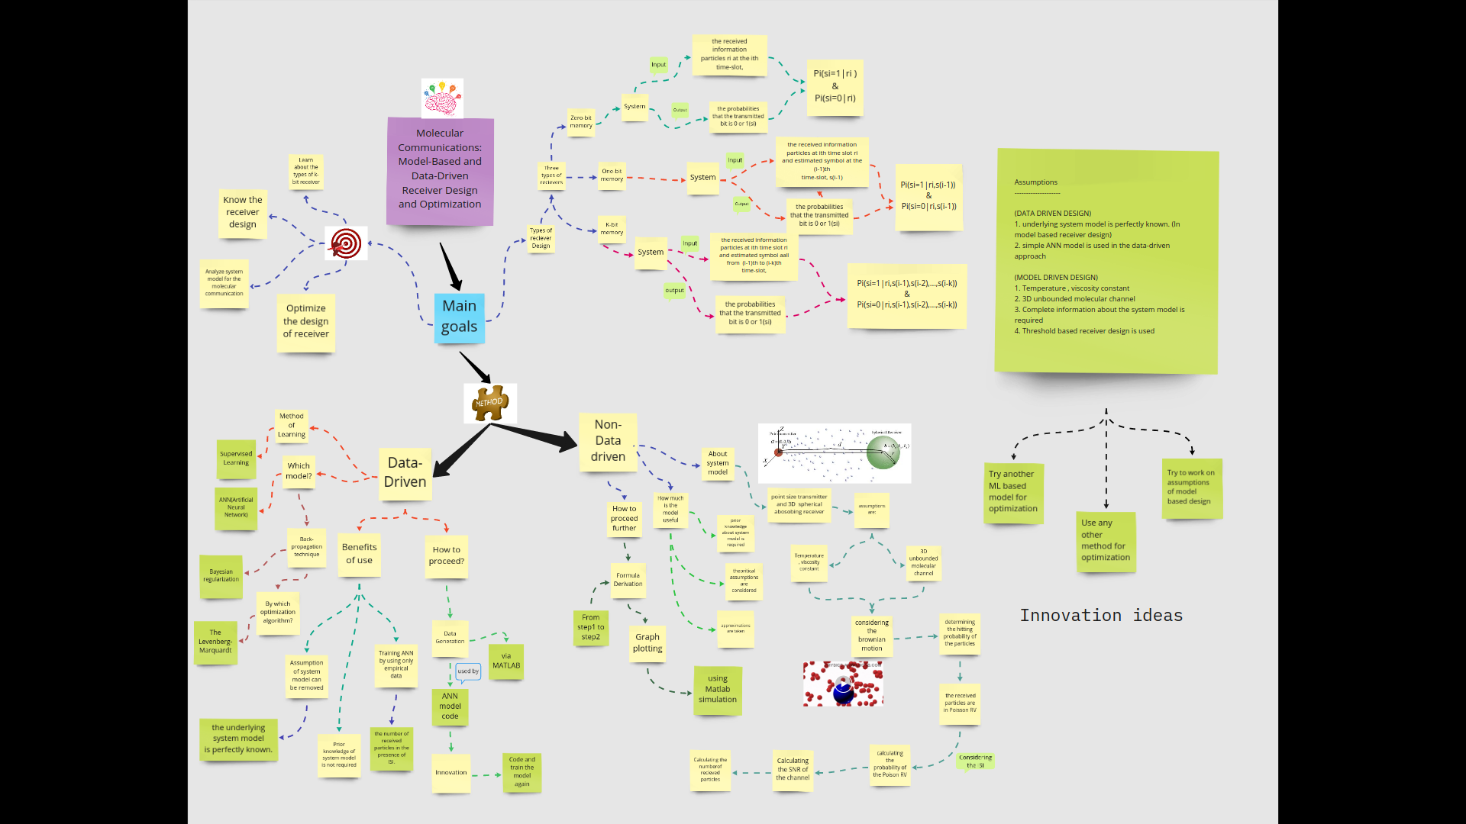
FRAME 3_A BASE ARTICLE

Slide 5
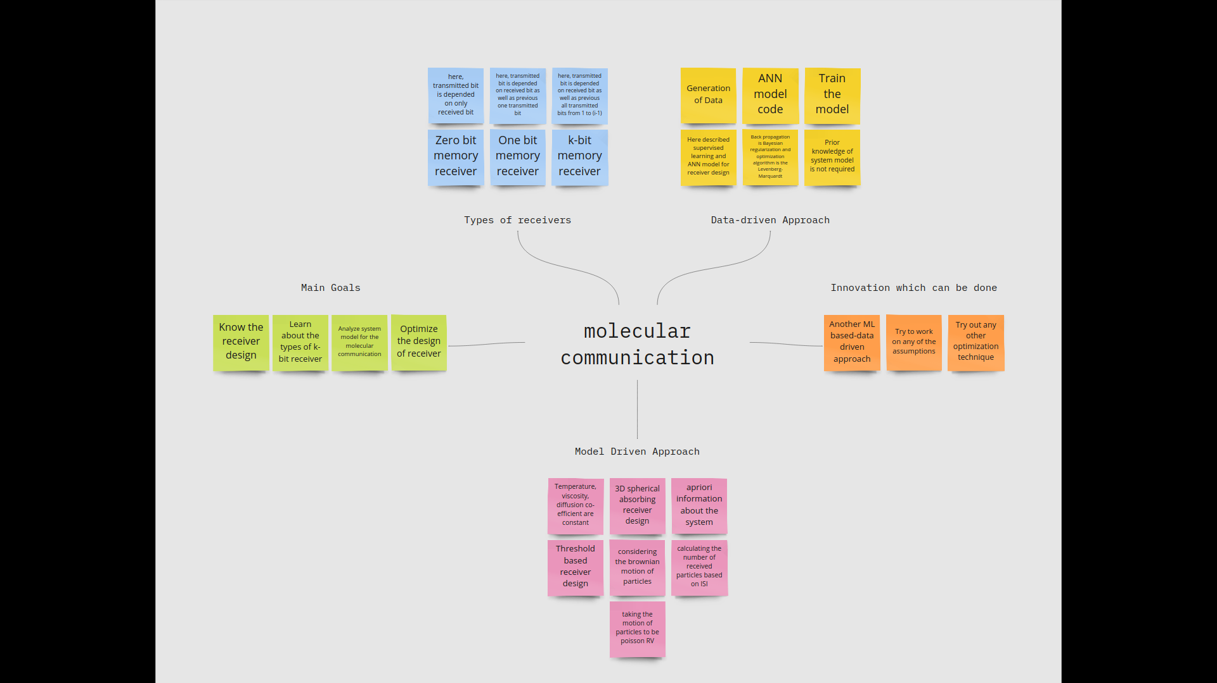
FRAME 3_B BASE ARTICLE EXPANSION

Slide 6
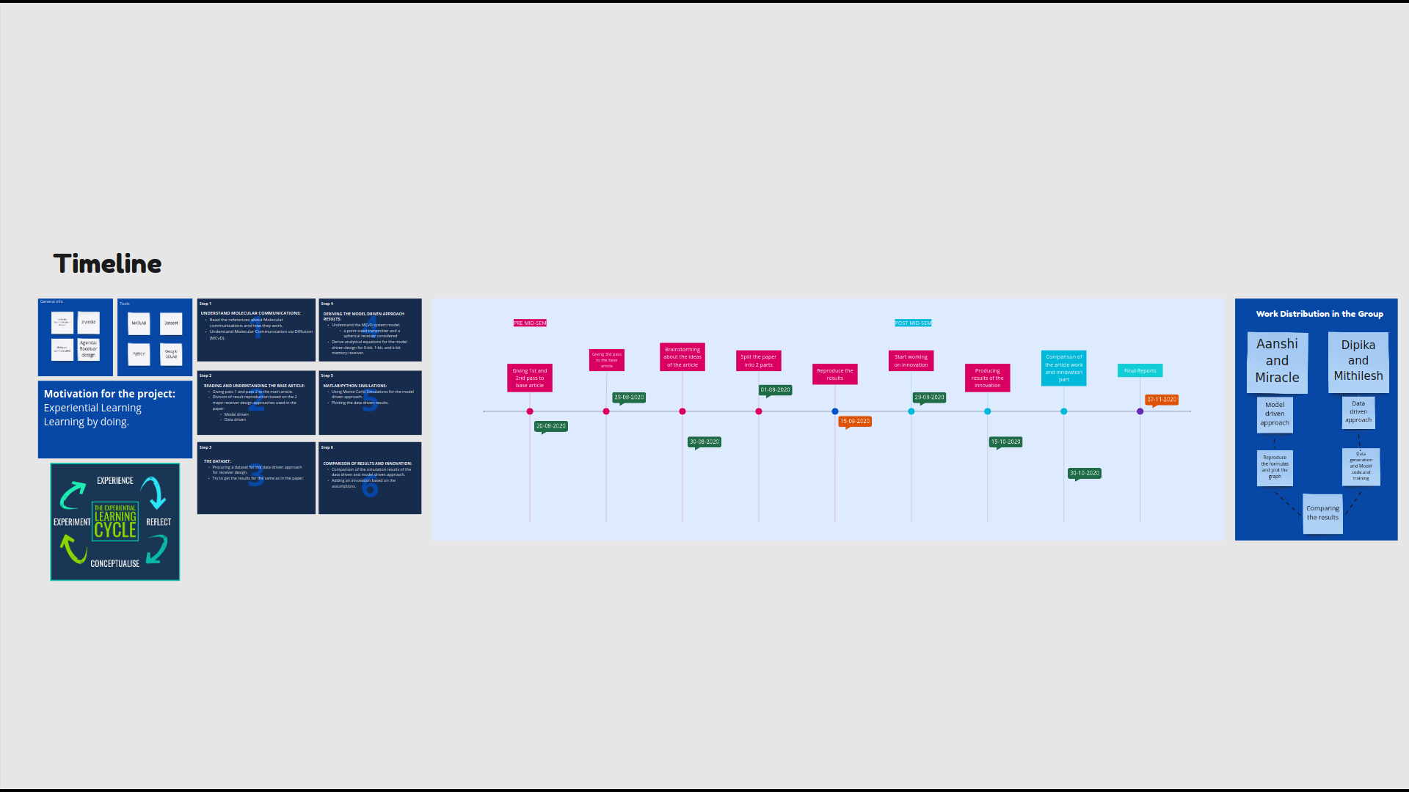
FRAME 3_C TIMELINE

Slide 7
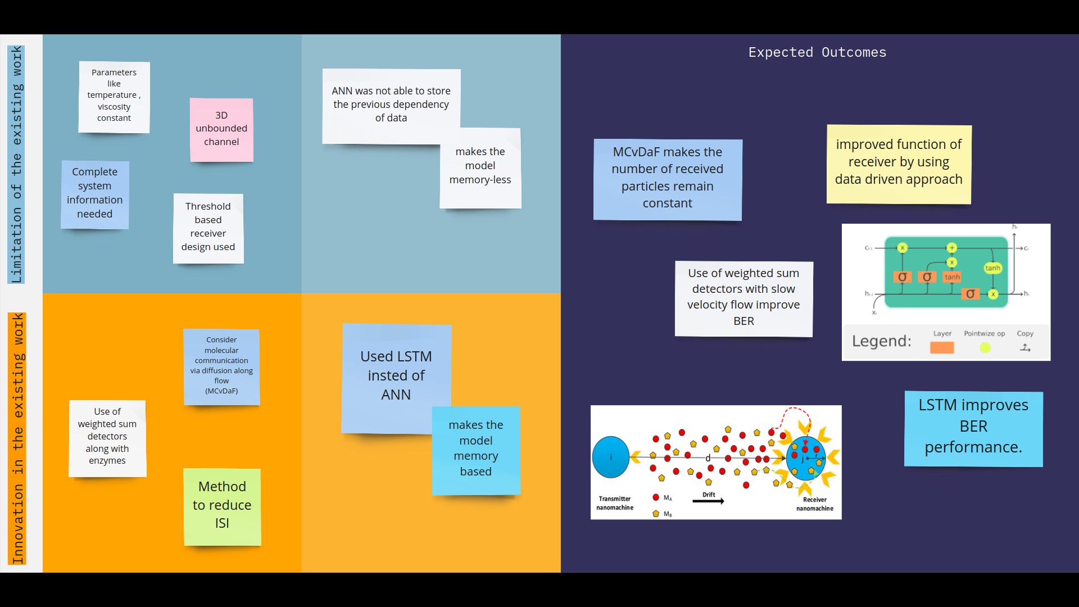
FRAME 4 INNOVATION

Slide 8
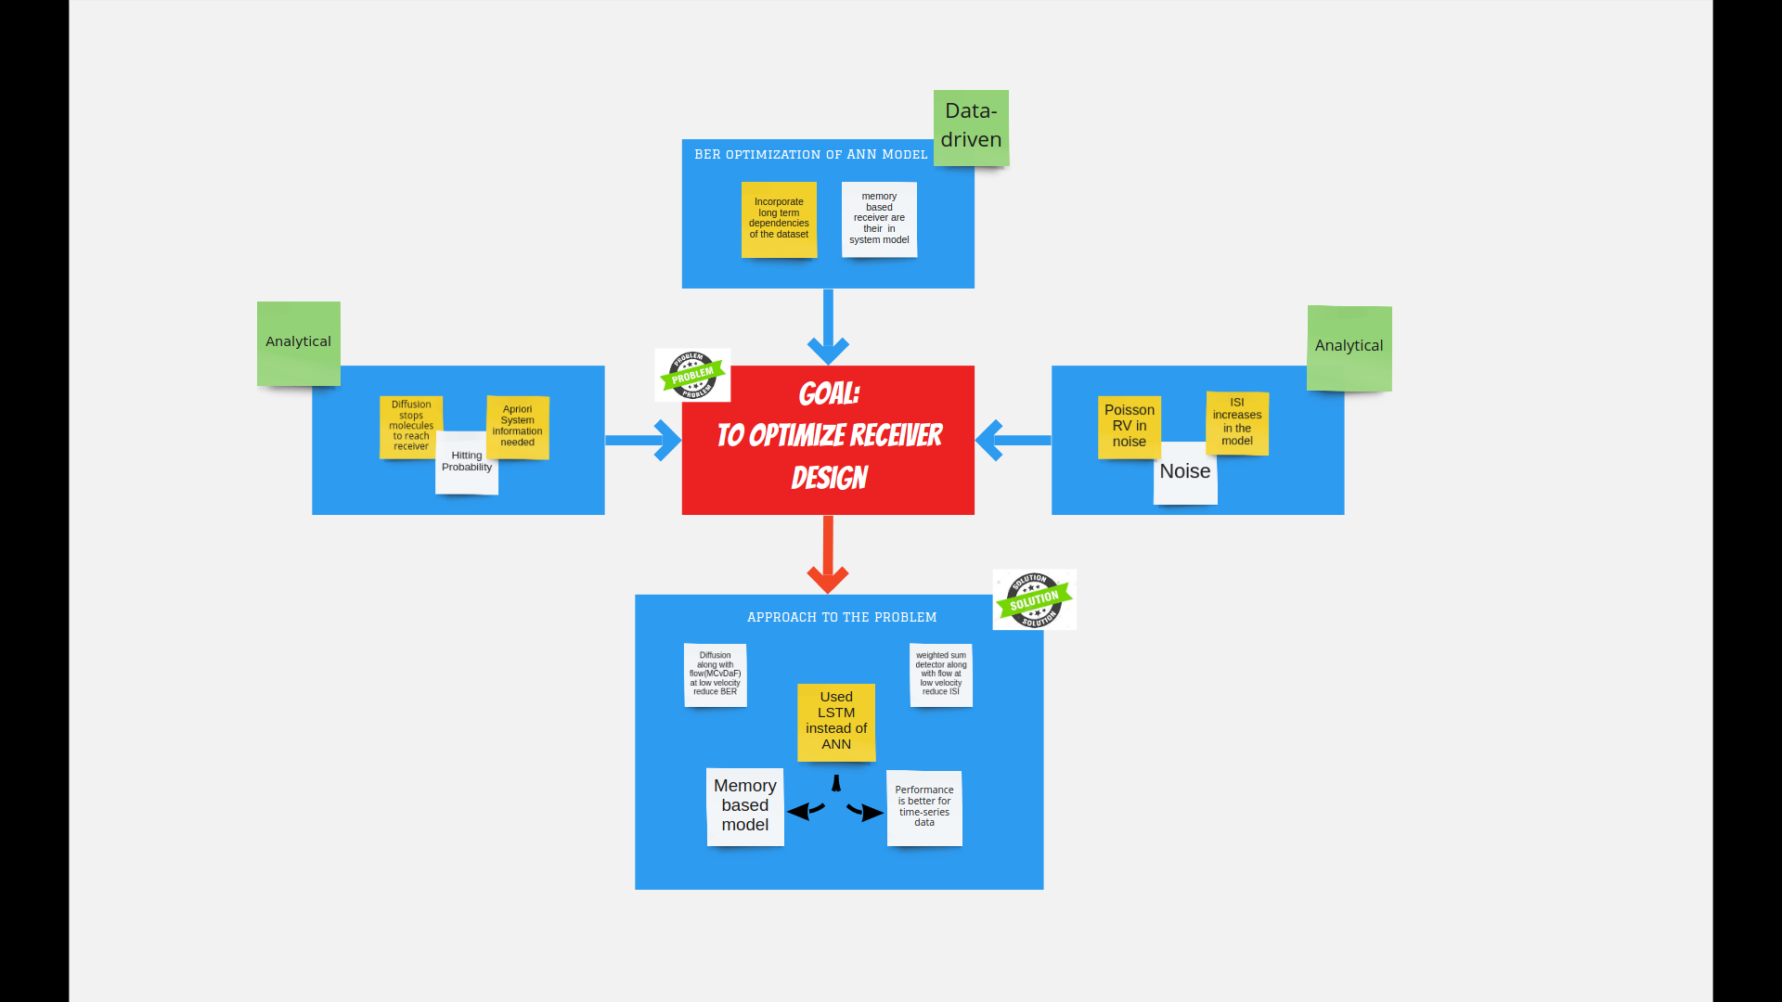
FRAME 5_A PROBLEM

Slide 9
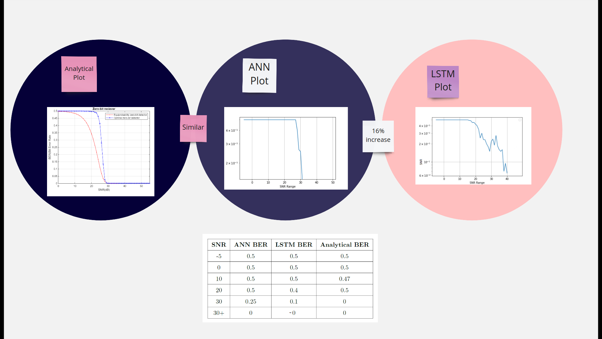
FRAME 5_B RESULTS

Slide 10

FRAME 5_C VIDEO

Slide 11
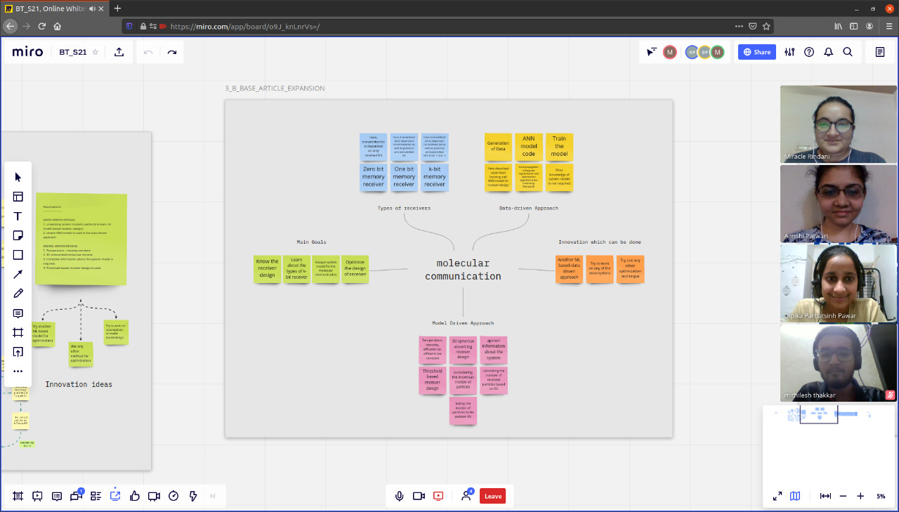
MIRO FRAME GROUP SNAPSHOT

